Slide 1
Automatic Alignment of Long Syllables in
A Cappella Beijing Opera
Georgi Dzhambazov, Yile Yang, Rafael Caro, Xavier Serra
CompMusic Project – Universitat Pompeu Fabra
georgi.dzhambazov@upf.edu
6th International Workshop on Folk Music Analysis
Dublin Institute of Technology
17 June 2016

Slide 2
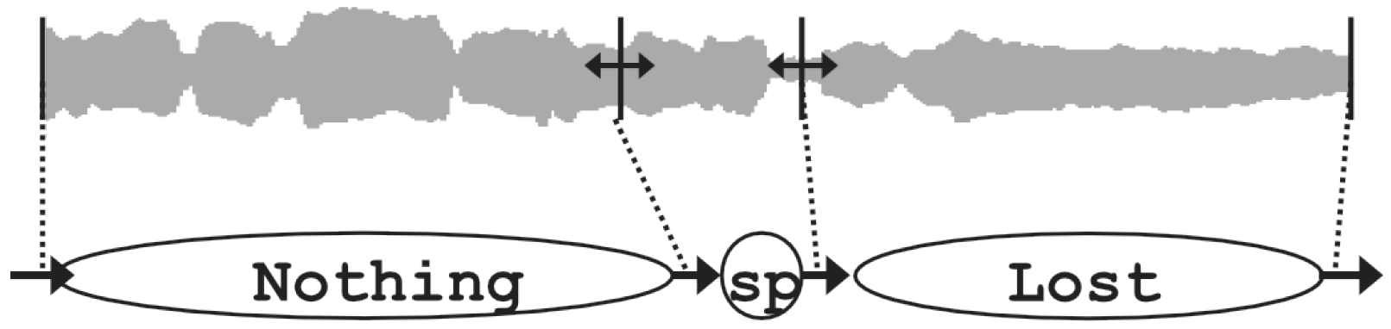
Introduction
What is lyrics-to-audio alignment?: automatic synchronization between an audio recording and its lyrics on phrase/word/syllable level
State-of-the-art approaches:
(Fujihara, 2012):
Mosty works on pop music with speech-like approach
approach | training | evaluation dataset
phoneme recognizer | speech | English pop, Japanese pop, Chinese pop
Notes:
Tenney and Polansky 1980
Cambouropoulos, 2001, 2006
Information Dynamics Of Music or IDyOM Pearce 2005, based on multiple viewpoints Conklin 1995

Slide 3
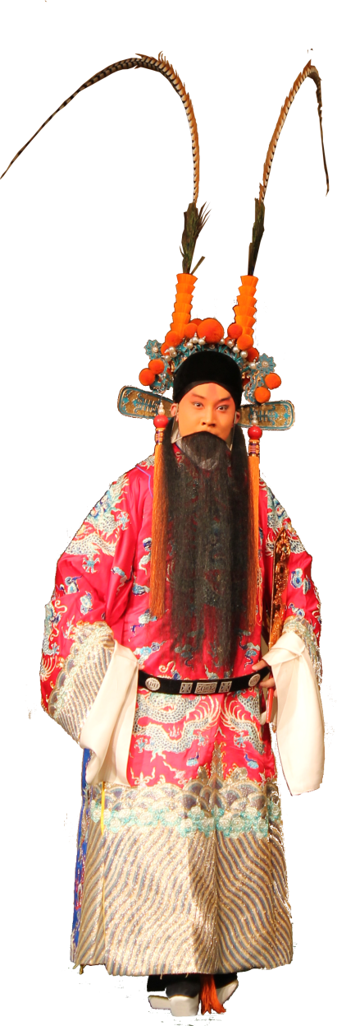
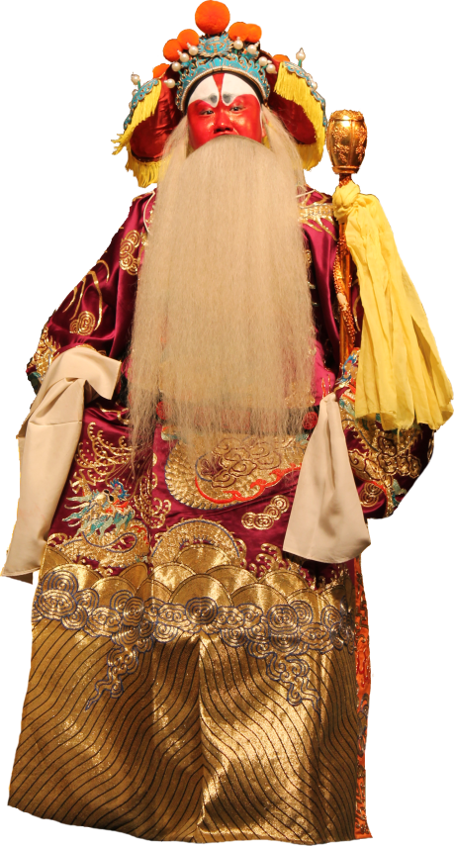
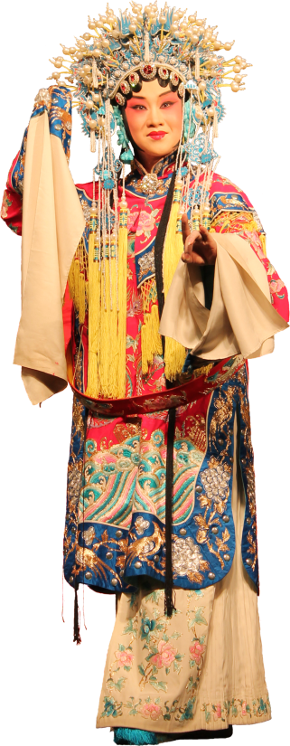
What is Beijing opera (a.k.a. Jingju)
Singing style based on traditional Chinese music
Language: Mandarin + dialects
Different metrical patterns (banshi):
manban (slow)
daoban (fast)
Different role types

Slide 4
Example excerpt from an aria
Average duration: 3.1 sec
Max duration: 8 sec
Notes:
Tenney and Polansky 1980
Cambouropoulos, 2001, 2006
Information Dynamics Of Music or IDyOM Pearce 2005, based on multiple viewpoints Conklin 1995

Slide 5
Example excerpt from an aria:
performance of speech-recognition-based alignment
Notes:
Tenney and Polansky 1980
Cambouropoulos, 2001, 2006
Information Dynamics Of Music or IDyOM Pearce 2005, based on multiple viewpoints Conklin 1995

Slide 6
Motivation (why automatic alignment)
Alignment: fundamental for following the opera script (Theatre performance)
Application of state-of-the-art:
not satisfactory results
Unaware of music-specific knowledge
Can be further used:
To facilitate musicological studies (navigation)
In Education:
Aid singing students and teachers (compare performances )

Slide 7
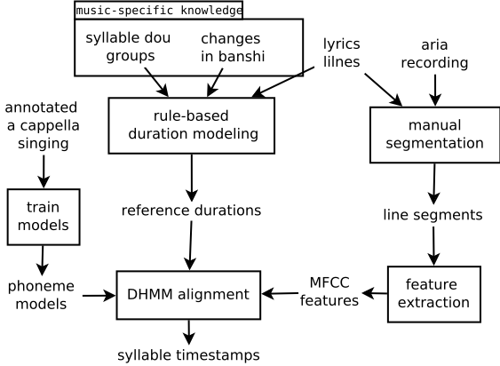
Approach Overview

Slide 8
Approach Overview
CONTRIBUTION with colors

Slide 9
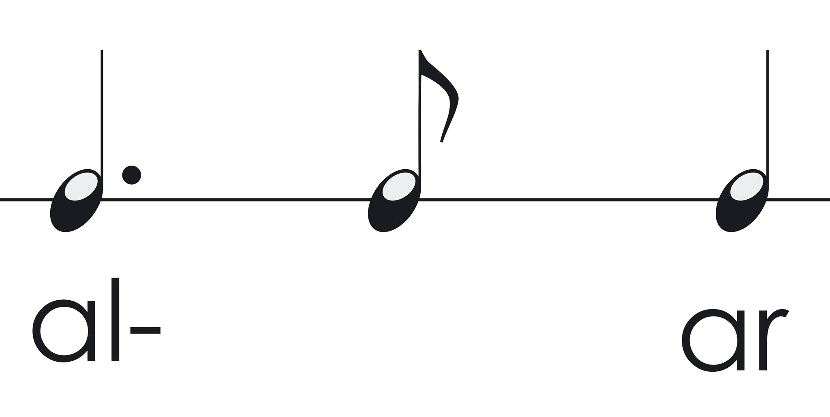
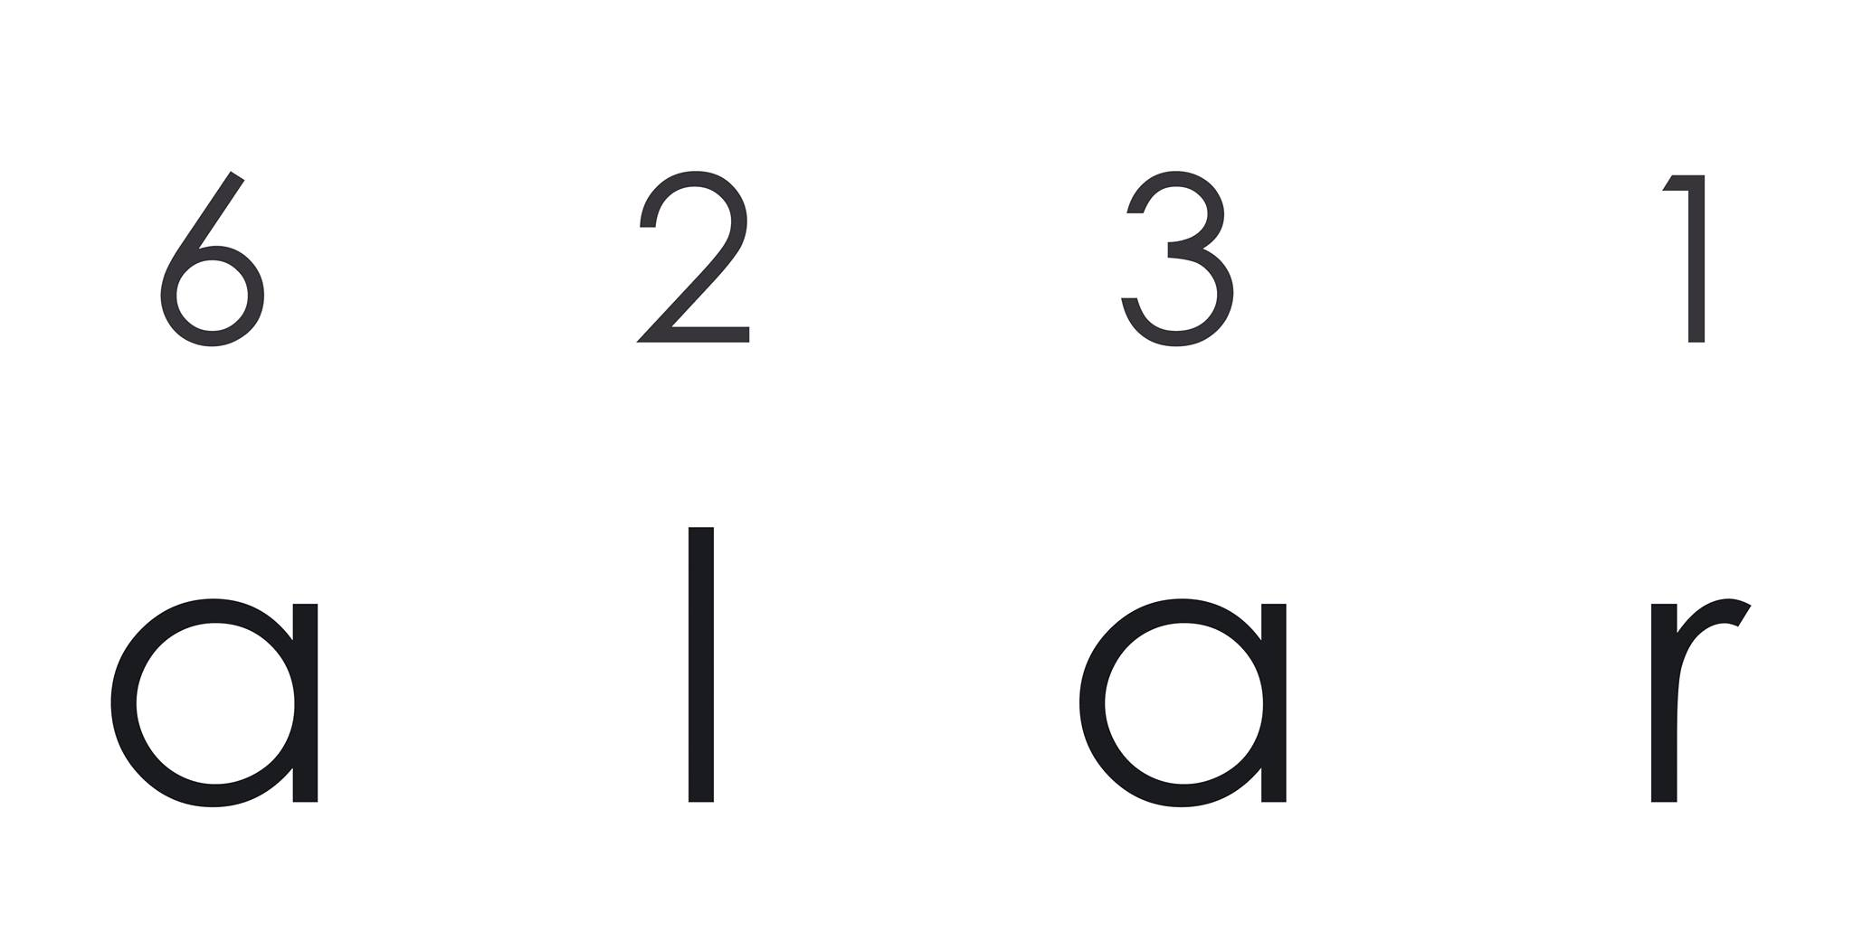
Syllable reference durations: model from score?
(Dzhambazov et al. 2015)
Restriction: need of score

Slide 10
Syllable reference durations: model from training data?
(Kruspe et al. 2015)
Restriction: looses context: position of a syllable in a line (same duration)

Slide 11

Jingju-specific principles
Lyrics from poetry: divided into lines
Each line has 2 or 3 dou
玉堂春含悲泪忙往前进，
想起了当年事好不伤情！
每日里在院中缠头似锦，
到如今只落得罪衣罪裙。

Slide 12
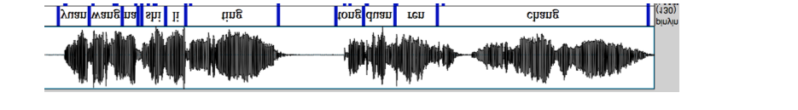
Syllable duration rules
1/5
1/4
1/3

Slide 13
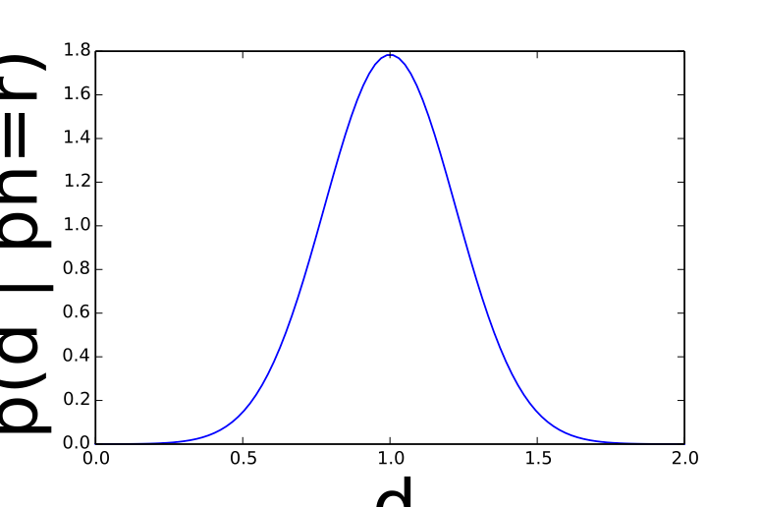
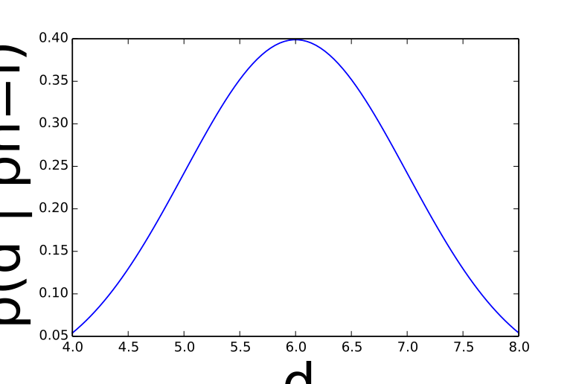
Duration-explicit hidden Markov model
1/5
1/4
1/3
….

Slide 14
Duration-explicit hidden Markov model

Slide 15
Phoneme models
Phoneme models
GMM + MFCCs
Trained on singing voice

Slide 16
Dataset stats

Slide 17
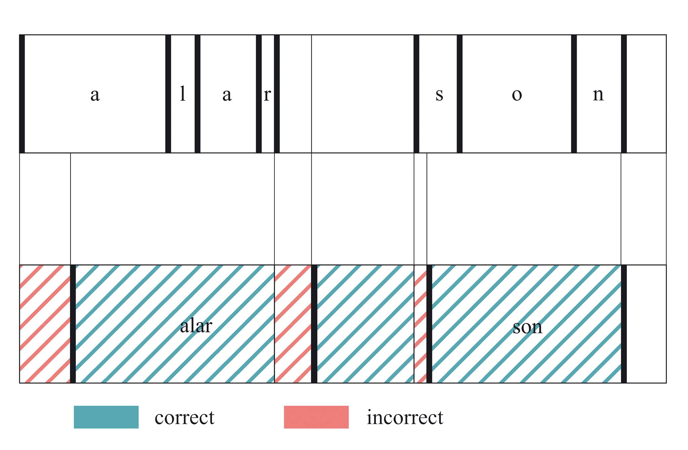
Evaluation

Slide 18
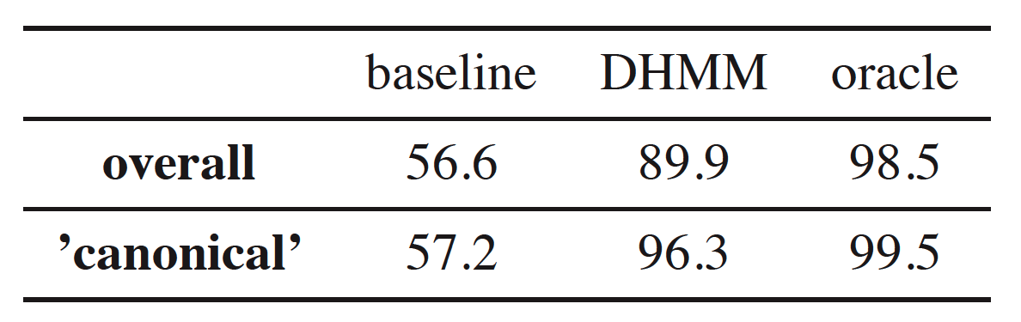
Results

Slide 19
Demo

